Slide 1

Bank Customer Relationship Management Analysis
Presented By: Anchal Rani Barnowal

Slide 2
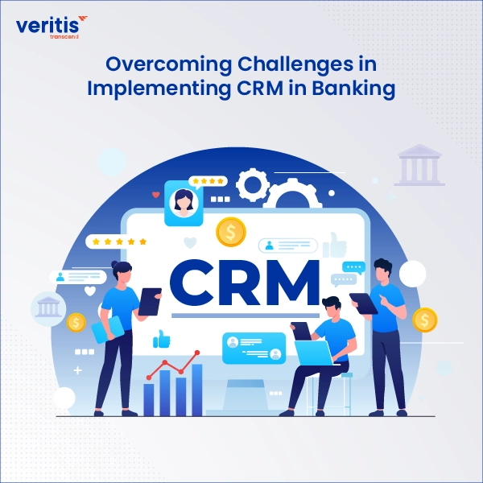
Introduction
Building an Analytical CRM dashboard empowers the bank to make strategic decisions by deeply analyzing customer data. This dashboard provides a comprehensive view of customer behaviors, helps in identifying patterns, and supports data-driven strategies. With advanced analytics, the bank can efficiently segment its customers, track behavioral changes, and forecast future actions to stay ahead in a competitive market.
The primary aim is to enhance customer satisfaction and retention by delivering personalized experiences and targeted campaigns. Ultimately, this Analytical CRM dashboard becomes a powerful tool for understanding customer dynamics, improving operational efficiency, and nurturing long-term, valuable customer relationships.

Slide 3

Problem Statement
The bank is currently facing challenges related to customer churn, which directly impacts revenue and profitability. To tackle this issue, a comprehensive analytical approach is undertaken, leveraging multiple datasets including customer demographics, transaction details, churn records, and active customer profiles.
This presentation explores the bank's customer churn rates, focusing on critical factors such as gender, recent churn trends, credit card ownership, the number of products used, credit scores, and regional distribution of departing customers. The objective is to uncover key reasons behind customer attrition and to recommend data-driven strategies aimed at improving customer satisfaction, reducing churn, and strengthening overall customer relationships.

Slide 4
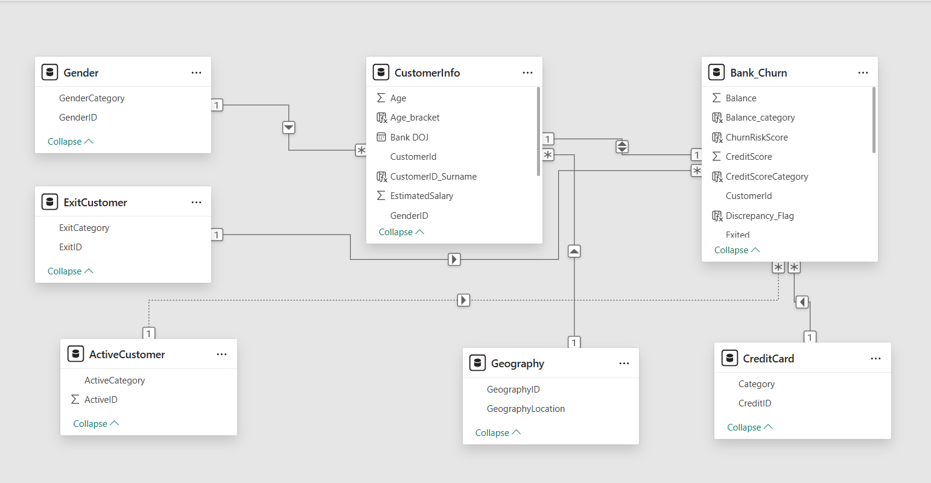
Database Model View

Slide 5
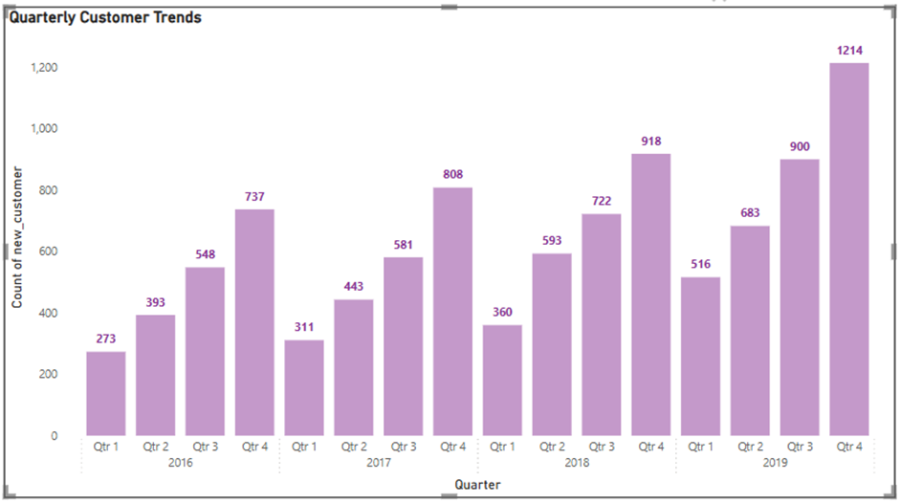
Customer Growth Analysis: Quarterly Trends by Year
Insights:
New customer acquisition shows a consistent year-on-year increase from 2016 to 2019.
Q4 is the strongest quarter every year, with the highest number of new customers.
2019 saw the highest growth, ending with 1,214 new customers in Q4.
Each year follows an upward quarterly trend, starting lower in Q1 and peaking in Q4. Conclusion: The number of customers has increased per year in the bank that is a good sign. Q4 consistently outperforms other quarters, suggesting effective year-end campaigns or seasonal banking behaviour. It is showing customers satisfaction with the bank services and products. From the data above, we could say that it is almost double in the 4 years of span.

Slide 6
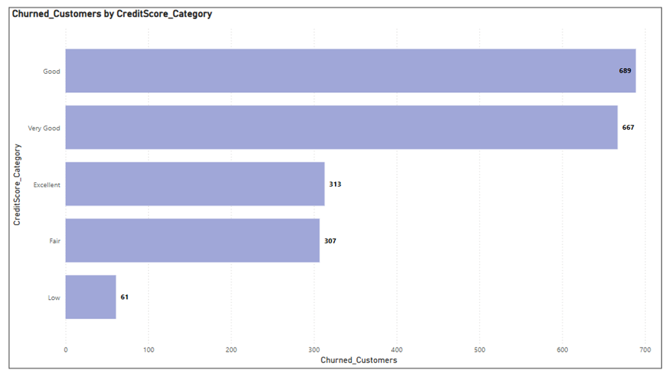
Churn Analysis: Credit Score Category Ranking
Insights: Based on the chart here is the ranking of credit score categories by number of churned customers (from highest to lowest):
Good — 689 customers
Very Good — 667 customers
Excellent — 313 customers
Fair — 307 customers
Low — 61 customers
So, Good and Very Good categories have the highest churn despite better credit scores, which is an interesting insight.

Slide 7
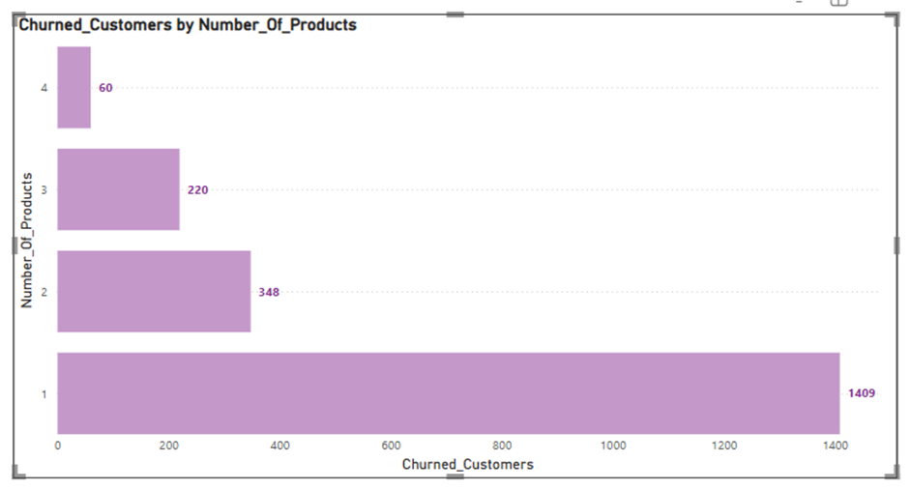
Churn Analysis by Number of Products
Insights:
Customers with more products may have higher satisfaction but could also feel overwhelmed, leading to frustration in some cases.
Conclusion:
The customers who use 3 or 4 products are less likely to churn.
The customer who uses just 1 product are the customers who have churned the most. So, focusing on those customer base can help to decrease the churn rate.

Slide 8
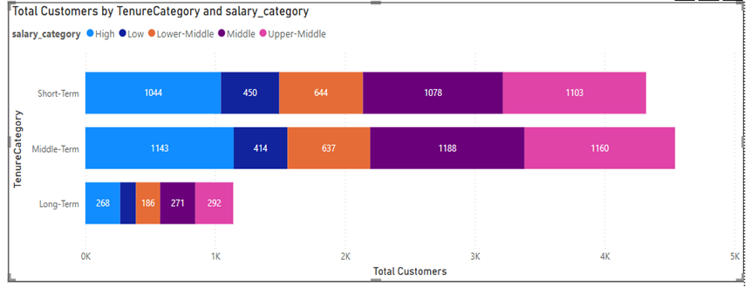
Customer Distribution by Tenure and Salary Segments
Insights: Customer Tenure Value Forecast
Middle-Term & Short-Term customers dominate. Focus retention here.
Long-Term customers are fewer but valuable — nurture them.
Combine Salary, Credit Score, and Tenure for predictive modelling.
Use models (like Logistic Regression) to predict tenure and churn.
Focus on Upper-Middle salary segments for higher lifetime value.
Prioritize retention and upselling for Middle-Term customers.
Recommendations:
Focus retention efforts on Short-Term, high-potential salary groups.
Upsell/cross-sell strategies for Middle-Term to extend tenure.
Incentivize Long-Term loyalty programs for sustainable revenue.

Slide 9
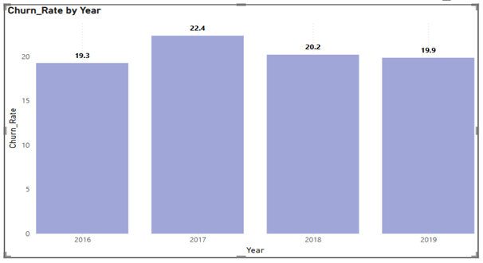
Year wise Churn Rate
Insights:
From 2016 to 2019, the average churn rate was around 20%, which is not ideal since a lower churn rate is preferable.
A high churn rate can suggest that customers are dissatisfied with the services or do not find them valuable.
Recommendations:
Improve Customer Service: Enhance the quality and responsiveness of customer support to increase satisfaction.
Launch Loyalty Programs: Offer rewards and incentives to encourage long-term customer retention.

Slide 10
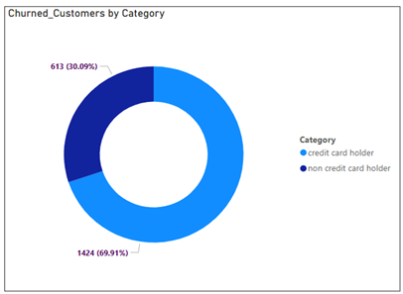
Impact of Credit Card on Churn
Insights:
Credit Card Ownership: According to the chart, a significantly higher number of customers with credit cards exited (1,424) compared to those without credit cards (613).
Recommendations:
Review and enhance credit card reward programs to increase value for customers.
Consider reducing or restructuring card fees to improve satisfaction.
Launch targeted retention offers for existing credit card holders.
Conduct customer feedback surveys to understand reasons for dissatisfaction.
Promote educational campaigns on credit card benefits to increase engagement.

Slide 11
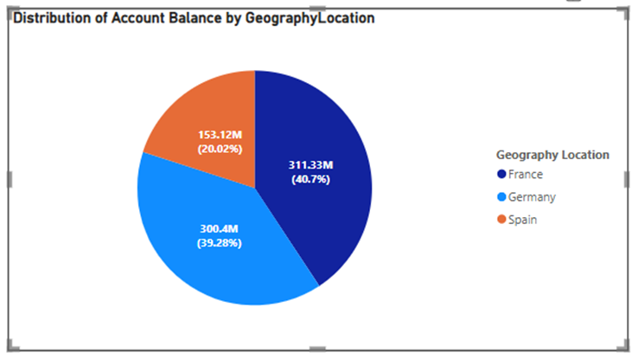
Balance Distribution across Location
Insights: There are currently three regions in the dataset: France, Germany, and Spain. To determine the distribution of account balances, we calculate the Account balances and group them by the regions (Geography).
The distribution of account balance by geography shows that France holds the largest share with 311.33M (40.7%), followed closely by Germany with 300.4M (39.28%), and Spain holds 153.12M (20.02%).

Slide 12
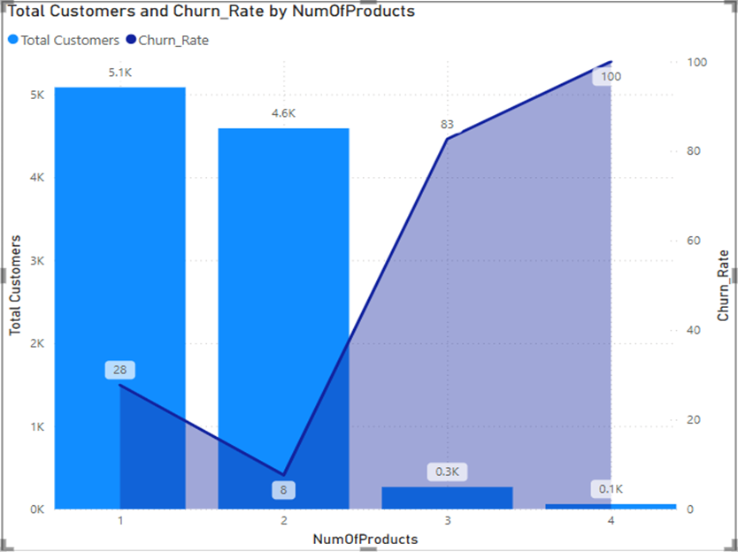
Customer Distribution and Churn Rate by Product Holding
Insights: The data shows that customers with fewer products tend to have a lower churn rate compared to those who have purchased more products.
Recommendations:
Target New Customers: Focus on acquiring customers who haven't purchased any products by offering discounts or promotions to encourage their first purchase.
Upsell and Cross-Sell: Leverage the lower churn rates among customers with multiple products by recommending complementary products or services to those who have already made a purchase.

Slide 13
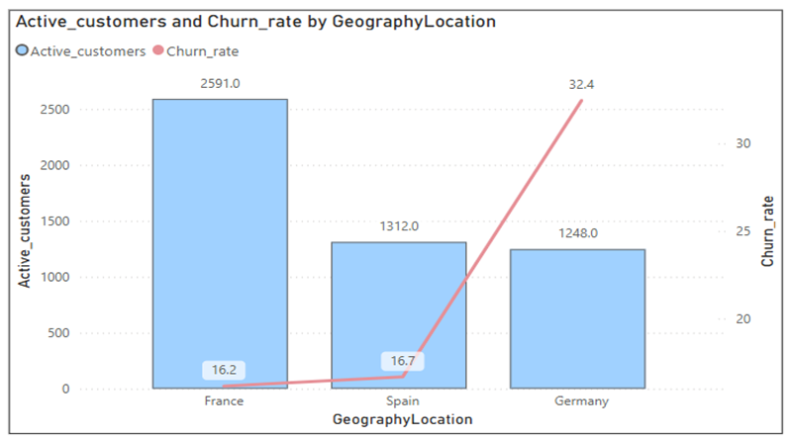
Active Customers & Churn Rate by Locations
Insights:
France: Highest active members (2591) and low churn rate (16.2%). Strong retention.
Germany: High churn rate (32.4%) despite fewer active members (1248). Retention challenges.
Spain: Same active members as Germany (1312) but lower churn rate (16.7%). Stable retention. Recommendations:
Germany:Investigate churn reasons via customer feedback.
Enhance customer experience and offer incentives to retain customers.
France:Maintain strong retention with proactive churn monitoring.Leverage growth through referral campaigns and upselling.
Spain:Expand the customer base with promotional campaigns. Fine-tune retention strategies to match France's performance.

Slide 14
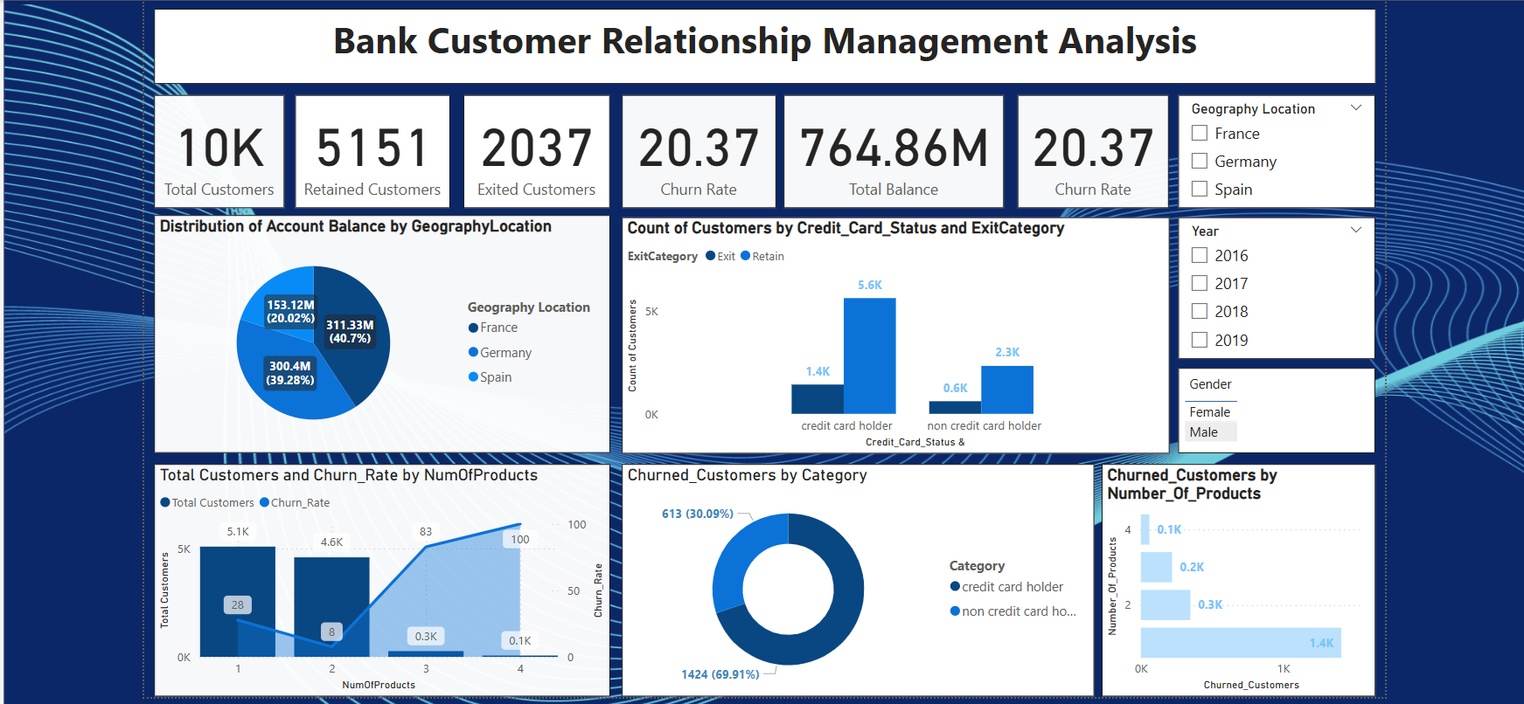
Dashboard

Slide 15
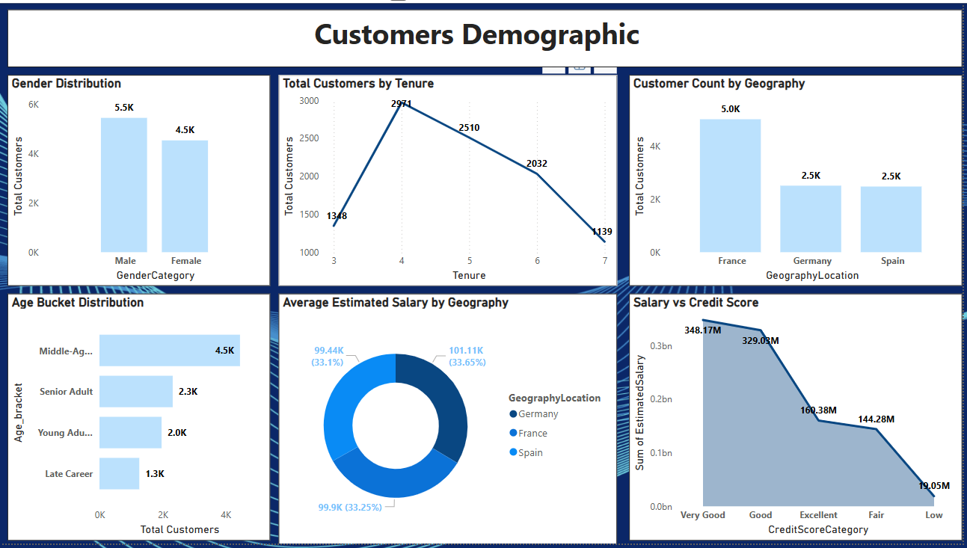
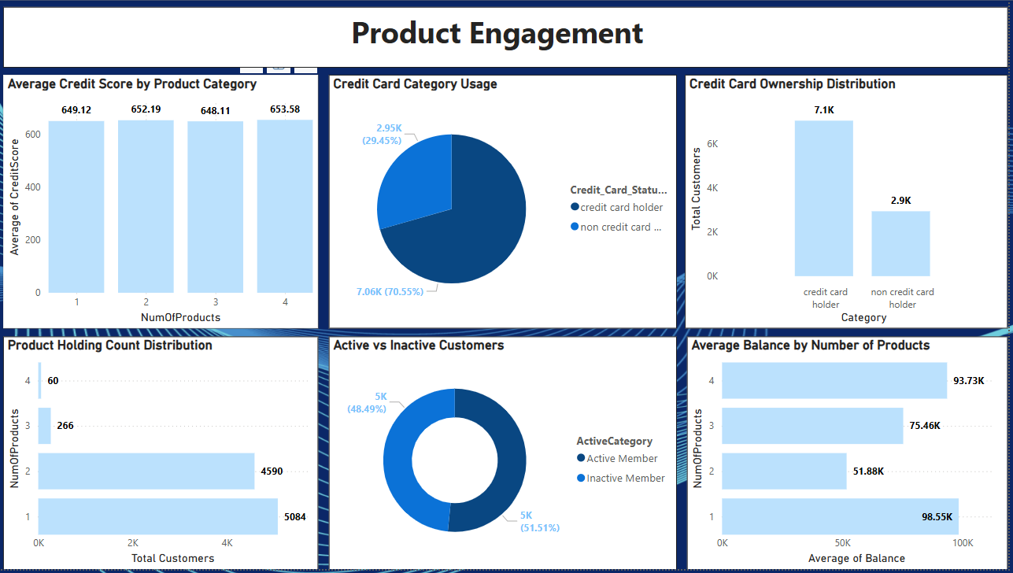
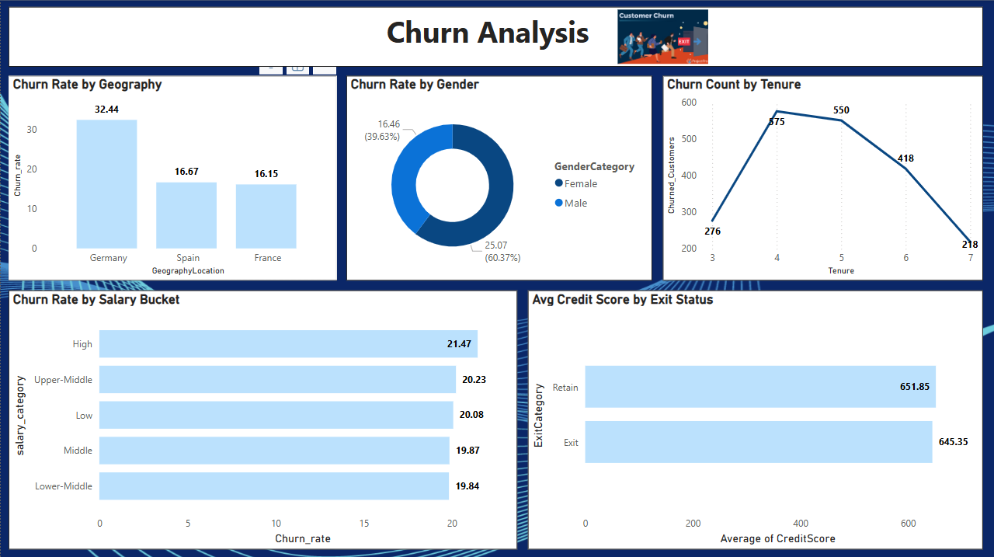

Slide 16
Conclusion
Churn Analysis: High churn is linked with low credit scores, fewer products, and inactive membership status.
Risk Segments Identified: Younger customers, low balance holders, and specific regions showed higher churn and financial risk.
Credit Score Impact: Customers with ‘Low’ and ‘Fair’ credit scores have a higher probability of leaving.
Tenure Insights: Shorter tenure customers are more prone to churn; retention strategies should target new joiners.
Outliers Detected: Balance distribution among retained customers shows few high-balance outliers.
Key KPIs Monitored: Dashboard effectively tracks churn trends, risk factors, customer value, and engagement metrics.
Actionable Strategies: Personalized offers, improving customer engagement, and targeted campaigns can reduce churn.
Data-Driven Approach: Continuous monitoring and predictive modeling will enhance customer satisfaction and profitability.

Slide 17
Recommendations
Implement Targeted Retention Campaigns: Focus on high-risk segments: low credit score, short tenure, and inactive members.
Enhance Customer Engagement: Promote cross-selling of products and increase active membership.
Refine Predictive Models: Continuously improve churn prediction and lifetime value models using updated data.
Monitor KPIs Regularly: Use dynamic dashboards for real-time tracking of churn, risk, and customer satisfaction.
Feedback Loop Integration: Collect customer feedback to fine-tune services and offers.
Expand Data Scope: Incorporate transaction history and external factors for deeper insights.

Slide 18
Thank You

